Slide 1
Diabetes prediction analysis

Slide 2
Abstract
This project analyzes diabetes-related health data using Power BI to identify patterns and risk factors such as BMI, blood glucose level, HbA1c level, age, gender, smoking history, heart disease, and hypertension. An interactive dashboard was created to visualize these factors and identify high-risk groups, helping in better understanding and data-driven healthcare insights.

Slide 3
Problem Statement
The problem is to analyze patient health data and identify key factors that influence diabetes occurrence. By using data visualization, the project helps detect patterns in BMI, blood glucose levels, HbA1c, age, gender, and smoking history to identify high-risk groups and support early diagnosis.

Slide 4
DATASET OVERVIEW
The dataset contains 20,000 patient records related to diabetes health indicators.
Each record represents one individual with demographic and medical details.
The dataset includes multiple factors that influence diabetes risk.
It helps analyze the relationship between lifestyle, medical conditions, and diabetes occurrence.
The data is used to build interactive visualizations and insights using Power BI.

Slide 5
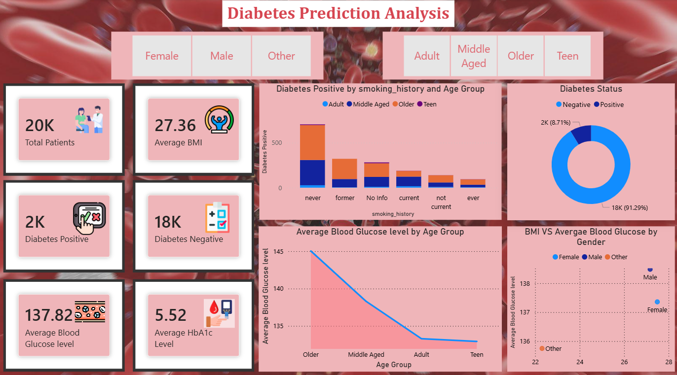
DASHBOARD

Slide 6
Prediction and analysis
Analyzed patient health data to identify patterns related to diabetes occurrence.
Examined key factors like BMI, Blood Glucose, HbA1c, Age, Smoking History, Hypertension, and Heart Disease.
Used Power BI dashboards and visualizations to explore relationships in the data.
Identified high-risk groups and important contributing factors to diabetes.

Slide 7
CONCLUSION
Developed an interactive dashboard for diabetes data analysis.
Simplified complex healthcare data using visual analytics.
Enabled better understanding of health indicators and disease patterns.
Demonstrated the role of data analytics in healthcare decision support.

Slide 8
Thank you

